Slide 1

Sprint 4 Design Review
1095-B TAX DOCUMENT
Friday, March 18, 2022

Slide 2
Agenda
01
VAnotify Email & SMS updates
02
Design Updates
03-17 Design review
Agenda

Slide 3
VAnotify Email & SMS updates
03-17 Design review
Design
3

Slide 4
VAnotify Email & SMS: Initial Announcement
Email
From: U.S. Department of Veteran Affairs
Subject: Your IRS 1095-B tax form is now available online
Dear [First_Name],
In an effort to reduce paper and provide more convenient options for Veterans to access documents, we have now made the IRS 1095-B tax form (proof of health coverage) available online for download from your records on Va.gov. Visit https://www.va.gov/records/download-your-irs-1095-b to download and/or print a copy of this form.
Thank you, VA.gov
SMS
U.S. Department of Veteran Affairs: Now you can get your IRS 1095-B tax form (proof of health coverage) online. To download, visit: https://www.va.gov/records/download-your-irs-1095-b.
03-18 Design review
Research
4

Slide 5
VAnotify Email & SMS: Automated Notification
Email
From: U.S. Department of Veteran Affairs
Subject: Your 2022 1095-B tax form is available for download
Dear [First_Name],
Your 2022 IRS 1095-B tax form (proof of health coverage) is now available for download. If you would like a copy for your records, please visit: https://www.va.gov/records/download-your-irs-1095-b.
Thank you,
VA.gov
SMS
U.S. Department of Veteran Affairs: Your [year] IRS 1095-B tax form (proof of health coverage) is now ready for download. Please visit: https://www.va.gov/records/download-your-irs-1095-b.
03-18 Design review
Research
5

Slide 6
VAnotify Email & SMS: Form Updated Notification
Email
From: U.S. Department of Veteran Affairs
Subject: Updates to your 1095-B have been processed
Dear [First_Name],
Thank you for contacting us. Requested changes to your 2022 IRS 1095-B tax form (proof of health coverage) have been updated in our system. To download and/or print a copy of the revised form, please visit: https://www.va.gov/records/download-your-irs-1095-b.
If you have not authorized this request or have any questions, please contact the Enrollment Center at 1-877-222-VETS (8387).
Thank you,
VA.gov
SMS
U.S. Department of Veteran Affairs: Changes to your [year] IRS 1095-B tax form have been processed. To download a copy, visit: https://www.va.gov/records/download-your-irs-1095-b. If you didn’t make this request, please call us at 1-877-222- 8387.
03-18 Design review
Research
6

Slide 7
Meeting with Content Team
The design and product team met with Patrick Sanders and Randi Hecht who report to Danielle Thierry, to review their copy edits for the unauthenticated 1095-B landing page
we can keep our intro copy as it was - mentioning that you don’t need to do anything with the 1095-B
The state info will remain, but be below the Download CTA
The states need to be bulleted because of their content pattern to bullet a list after 3 items
03-18 Design review
Design
7

Slide 8
Design updates
03-18 Design review
Design
8

Slide 9
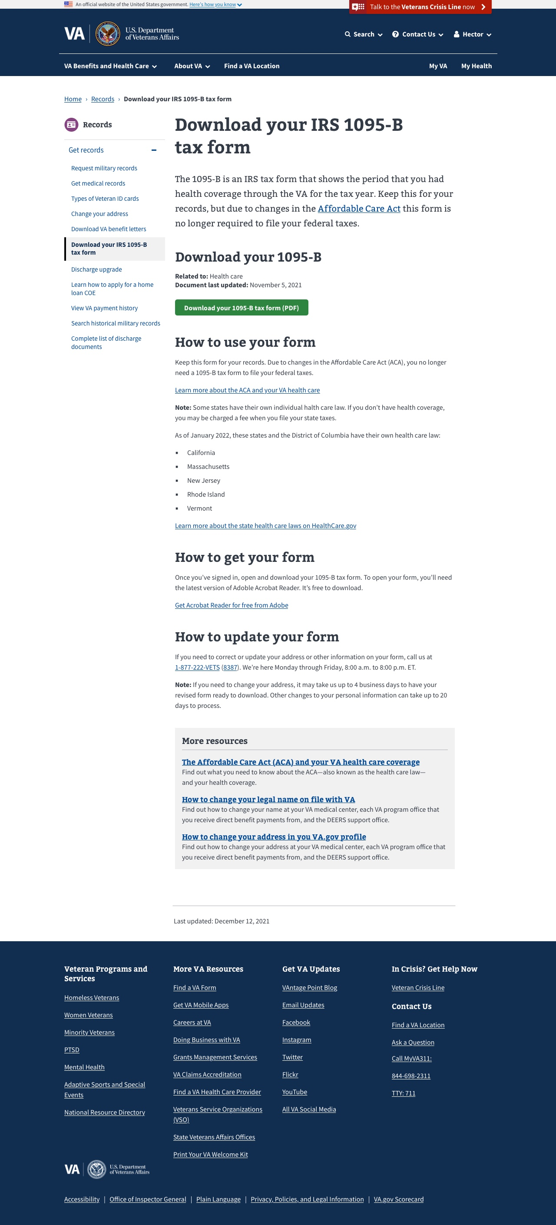
Default State: All
Based on revisions made by the sitewide content team
03-18 Design review
Design
9

Slide 10
03-18 Design review
Design
10

Slide 11
03-18 Design review
Design
11

Slide 12
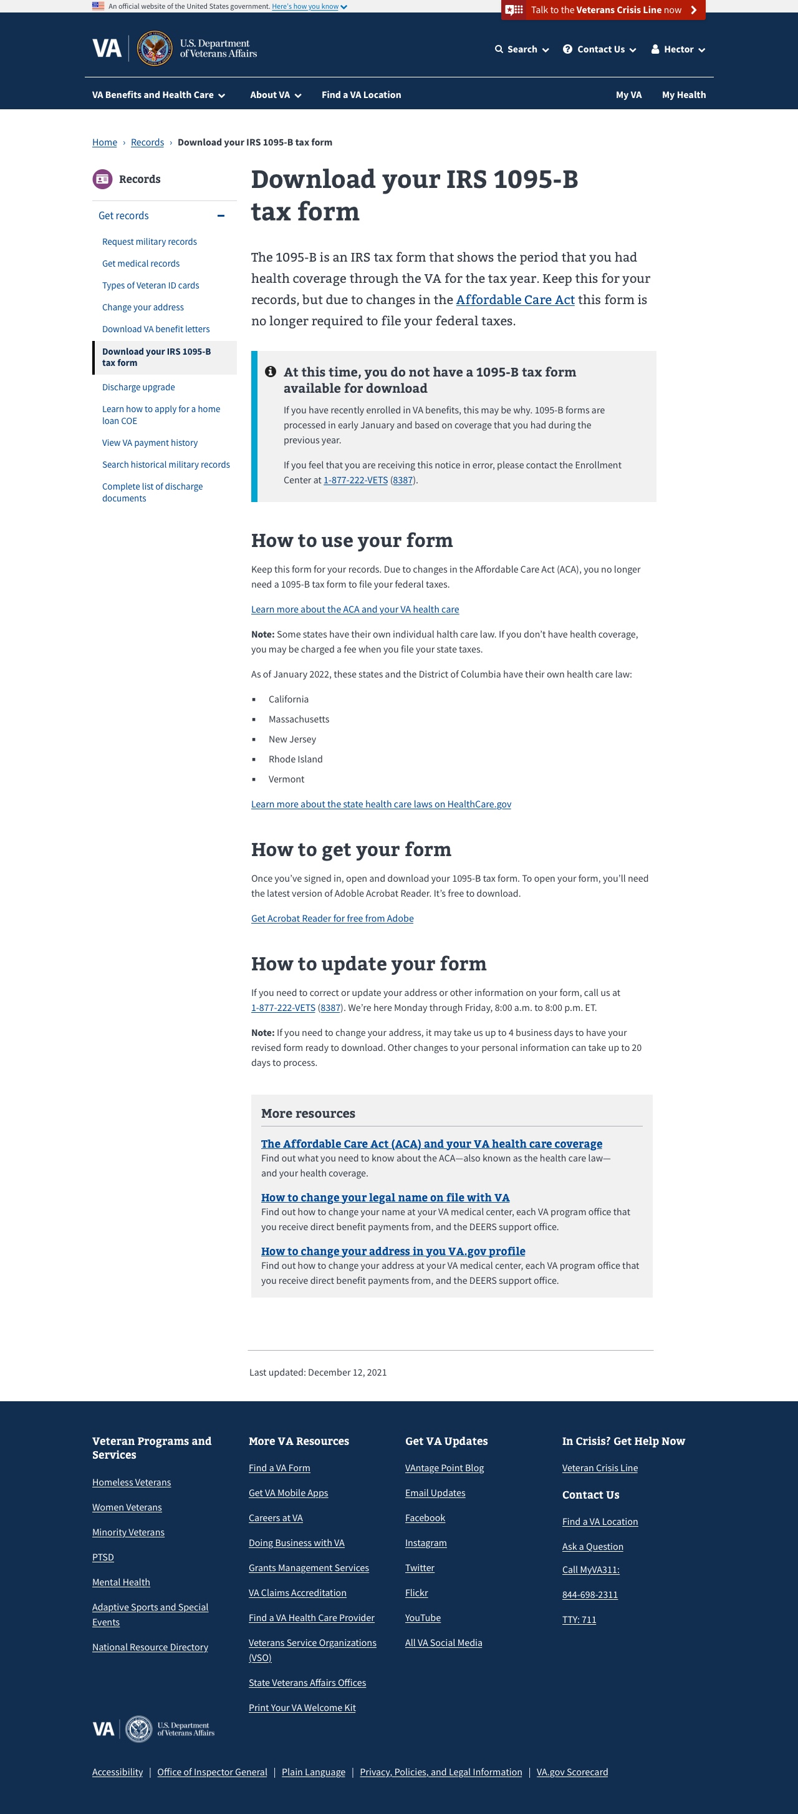
Error States
No previous year health coverage found
03-18 Design review
Design
12

Slide 13
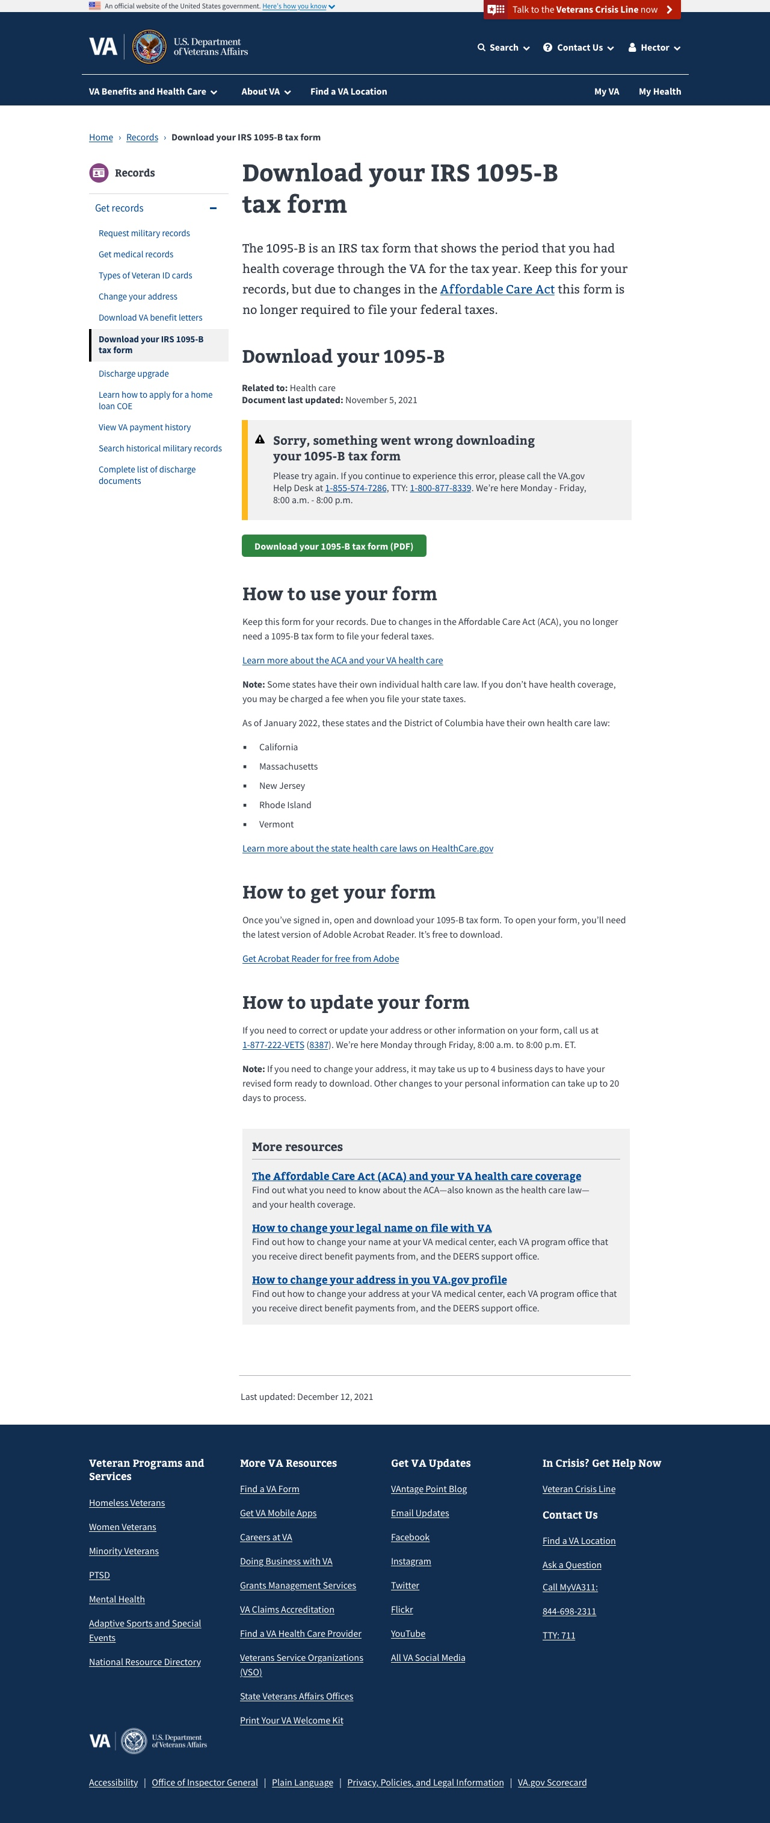
Error States
Technical error
03-18 Design review
Design
13

Slide 14
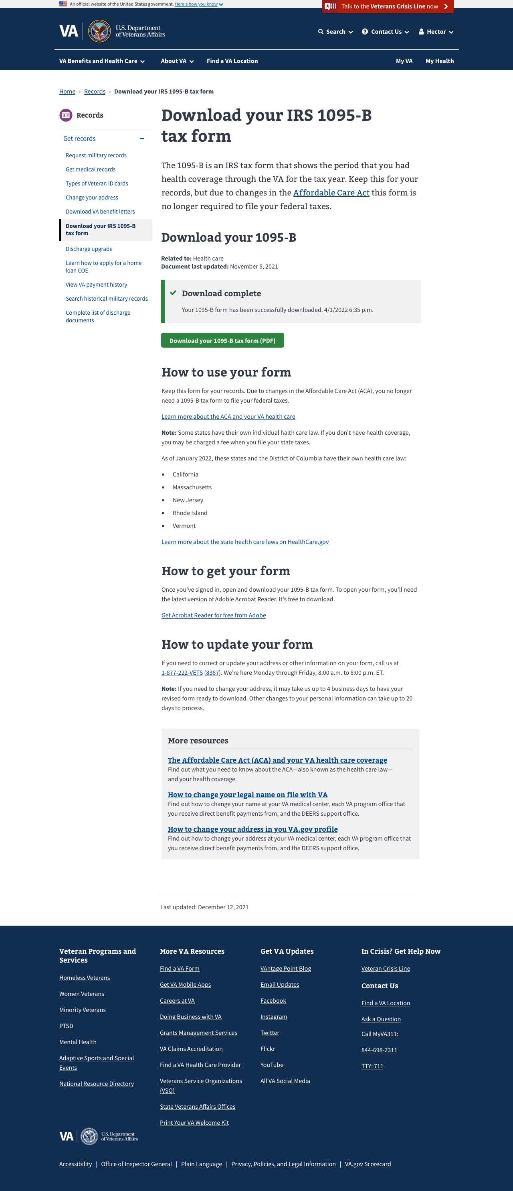
Confirmation State
If technically possible, confirmation state for successful download
03-18 Design review
Design
14

Slide 15
Next Steps
Confirm and review unauthenticated content and design updates made to staging by the sitewide team
Send Tracey 1095-B Tax Form Fact Sheet doc for review
03-18 Design review
Design
15

